Slide 1

Exception Handling
Handling Errors During the Program Execution
SoftUni Team
Technical Trainers
Software University
https://softuni.bg

Slide 2
Table of Contents
What Are Exceptions in Java?
The Throwable and Exception Classes
Types of Exceptions and Their Hierarchy
Handling Exceptions: try-catch-finally
Raising (Throwing) Exceptions: throw
Best Practices in Exception Handling
Defining Custom Exceptions Classes

Slide 3
Have a Question?
sli.do
#java-advanced

Slide 4

What Are Exceptions?
Notifications about Failed Operations

Slide 5
What Are Exceptions?
Exceptions handle errors and problems at runtime
Throw an exception to signal about a problem
Catch an exception to handle the problem
if (size < 0)
throw new Exception("Size cannot be negative!");
try {
size = Integer.ParseInt(text);
} catch (Exception ex) {
System.out.println("Invalid size!");
}

Slide 6
More About Exceptions
Exceptions occur when the normal flow of the program is interrupted due to problem (or error)
When an operation fails to execute at runtime
Example: trying to read a non-existing file
Exceptions allow the problematic situations to be handled at multiple levels
Simplify code construction and maintenance
Exception objects hold detailed information about the error: error message, stack trace, etc.

Slide 7
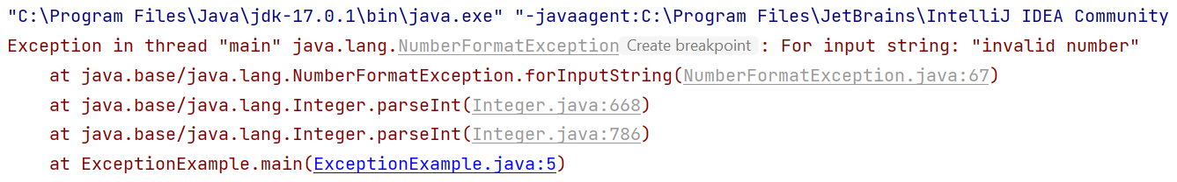
Unhandled Exception with Stack Trace
int x = Integer.parseInt("invalid number");
Error message
Stack trace

Slide 8
The Throwable Class
Exceptions in Java are objects
The Throwable class is a base for all Java exceptions
Contains information for the cause of the problem
Message – a text description of the exception
StackTrace – the snapshot of the "call stack" at the moment when the exception is throws
8

Slide 9
Types of Exceptions in Java
All Java exceptions inherit from java.lang.Throwable
Direct descendants of Throwable:
Error – not expected to be caught from the program under normal circumstances
Examples: StackOverflowError, OutOfMemoryError
Exception
Used for exceptional conditions that user programs could catch
Examples: ArithmeticException, IOException

Slide 10
Exceptions
Exceptions are two types:
Checked – an exceptions that should be obligatory handled → checked by the compiler during the compilation
Also called compile-time exceptions
Unchecked – exceptions that occur at the time of execution
Also called runtime exceptions, not obligatory handled
public static void main(String args[]) {
File file = new File("non-existing-file.txt");
FileReader fr = new FileReader(file);
}
FileNotFoundException

Slide 11
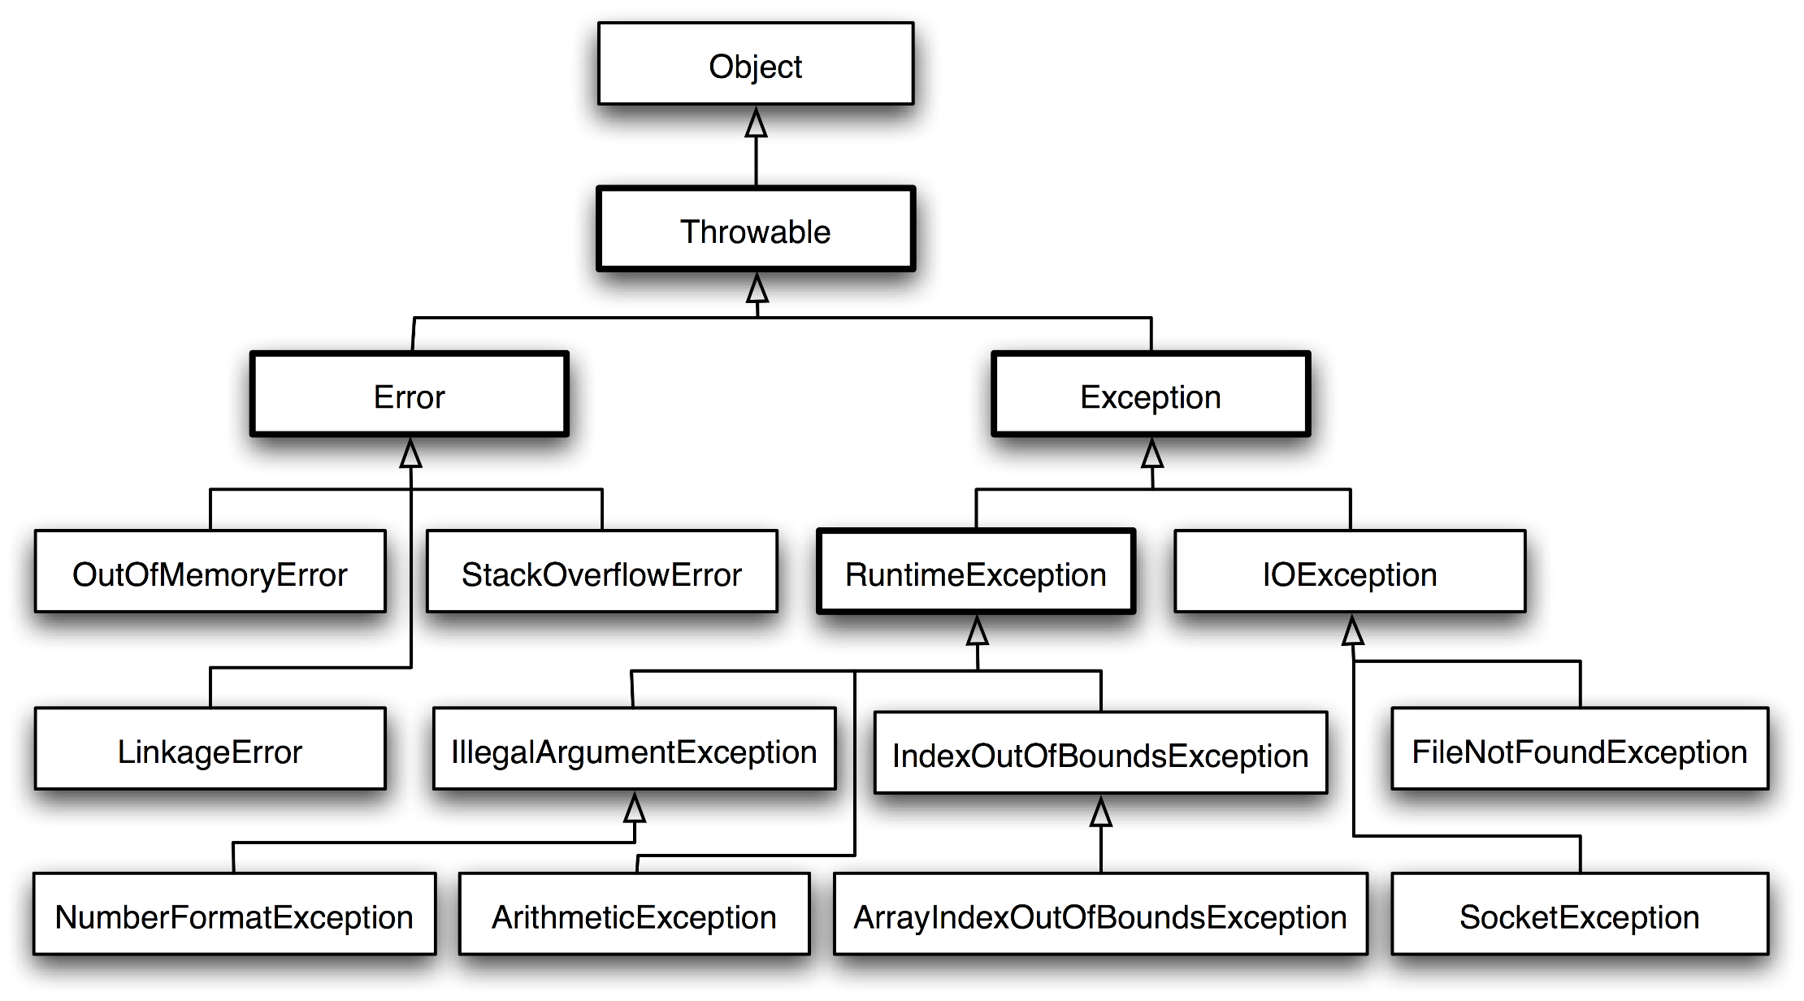
Exception Hierarchy in Java

Slide 12

Handling Exceptions
try-catch
Using try-catch-finally

Slide 13
How Do Exceptions Work?
try
Try to run this code
Run this code when there is an exception
catch
finally
Always run this code

Slide 14

Handling Exceptions
In Java exceptions can be handled by the try-catch construction
catch blocks can be used multiple times to process different exception types
try {
// Do some work that can raise an exception
} catch (SomeException) {
// Handle the caught exception
}
14

Slide 15
Using try-catch – Example
Scanner scanner = new Scanner(System.in);
String s = scanner.nextLine();
try {
Integer.parseInt(s);
System.out.printf(
"You entered a valid integer number: %s", s);
} catch (NumberFormatException ex) {
System.out.println("Invalid integer number!");
}
15

Slide 16

Handling Exceptions
When catching an exception of a particular class, all its descendants (child exceptions) are caught too, e.g.
Handles IndexOutOfBoundsException and its descendants ArrayIndexOutOfBoundsException and StringIndexOutOfBoundsException
try {
// Do some work that can cause an exception
} catch (IndexOutOfBoundsException iobEx) {
// Handle the caught out-of-bounds exception
}

Slide 17
Find the Mistake!
String str = scanner.nextLine();
try {
Integer.parseInt(str);
} catch (Exception ex) {
System.out.println("Cannot parse the number!");
} catch (NumberFormatException ex) {
System.out.println("Invalid integer number!");
}
Should be last
Unreachable code

Slide 18
Problem: Number in Range
Write a program to enter an integer in certain range, e. g. 10-20
Read a range (two integers start <= end) and print the range
When an invalid number in entered or the number is out of range, print "Invalid number: {num}" and enter a number again
When the entered number is valid, print "Valid number: {num}"
10 20
5
xx
20
Range: [10...20]
Invalid number: 5
Invalid number: xx
Valid number: 20
-5 50
hi
-6
-1
Range: [-5...50]
Invalid number: hi
Invalid number: -6
Valid number: -1

Slide 19
Solution: Number in Range
private static int readNumberInRange(
Scanner scanner, int start, int end) {
while (true) {
String line = scanner.nextLine();
try {
int num = Integer.parseInt(line);
if (num >= start && num <= end)
return num; // Valid number (in range)
} catch (Exception ex) {
// Parse failed --> invalid number
}
System.out.println("Invalid number: " + line);
}
}

Slide 20
Solution: Number in Range (2)
public static void main(String[] args) {
Scanner scanner = new Scanner(System.in);
String[] range = scanner.nextLine().split(" ");
int start = Integer.parseInt(range[0]);
int end = Integer.parseInt(range[1]);
System.out.printf("Range: [%d...%d]\n", start, end);
int num = readNumberInRange(scanner, start, end);
System.out.println("Valid number: " + num);
}
Submit your solution to the judge: https://judge.softuni.org/Contests/Practice/Index/3294

Slide 21

Try-Finally
Executing a Cleanup Code in All Cases

Slide 22
The try-finally Statement
The statement:
Ensures execution of a given block in all cases
When exception is raised or not in the try block
Used for execution of cleaning-up code, e.g. releasing resources
try {
// Do some work that can cause an exception
} finally {
// This block will always execute
}

Slide 23
Try-finally – Example
static void tryFinallyExample() {
System.out.println("Code executed before try-finally.");
try {
String str = scanner.nextLine();
Integer.parseInt(str);
System.out.println("Parsing was successful.");
return; // Exit from the current method → executes the "finally" block
} catch (NumberFormatException ex) {
System.out.println("Parsing failed!");
} finally {
System.out.println("This cleanup code is always executed.");
}
System.out.println("This code is after the try-finally block.");
}

Slide 24

Throwing Exceptions
Using the "throw" Keyword

Slide 25
Using Throw Keyword
Throwing an exception with an error message:
Exceptions can accept message and cause (nested exception):
Note: if the original exception is not passed, the initial cause of the exception is lost
throw new IllegalArgumentException("Invalid amount!");
try {
…
} catch (SQLException sqlEx) {
throw new IllegalStateException("Cannot save invoice", sqlEx);
}

Slide 26
Throwing Exceptions
Exceptions are thrown (raised) by the throw keyword
Used to notify the calling code in case of an error or unusual situation
When an exception is thrown:
The program execution stops immediately
The exception travels over the stack
Until a matching catch block is reached to handle it
Unhandled exceptions display an error message

Slide 27
Re-Throwing Exceptions
Caught exceptions can be re-thrown again:
try {
Integer.parseInt(str);
} catch (NumberFormatException ex) {
System.out.println("Parse failed!");
throw ex; // Re-throw the caught exception
}

Slide 28
Throwing Exceptions – Example
public static double calcSqrt(double value) {
if (value < 0)
throw new ArithmeticException(
"Sqrt for negative numbers is undefined!");
return Math.sqrt(value);
}
public static void main(String[] args) {
try {
calcSqrt(-1);
} catch (ArithmeticException ex) {
System.err.println("Error: " + ex.getMessage());
ex.printStackTrace();
}
}

Slide 29
Problem: Square Root
Write a program that reads an integer number and calculates and prints its square root (with 2 digits after the decimal point)
If the number is invalid or negative, print "Invalid"
In all cases finally print "Goodbye"
Use try-catch-finally
xx
Invalid
Goodbye
9
3.00
Goodbye
20
4.47
Goodbye
-5
Invalid
Goodbye

Slide 30
Solution: Square Root
Scanner scanner = new Scanner(System.in);
try {
int num = Integer.parseInt(scanner.nextLine());
double sqrt = calcSqrt(num);
System.out.printf("%.2f\n", sqrt);
} catch (Exception ex) {
System.out.println("Invalid");
}
finally {
System.out.println("Goodbye");
}
Submit your solution to the judge: https://judge.softuni.org/Contests/Practice/Index/3294

Slide 31

The "throws" in Method Declarations
Forcing Invokers to Handle Certain Exceptions

Slide 32
Using "throws" in Method Declaration
static String readTextFile(String fName) throws IOException {
BufferedReader reader =
new BufferedReader(new FileReader(fName));
StringBuilder result = new StringBuilder();
try {
String line;
while ((line = reader.readLine()) != null)
result.append(line + System.lineSeparator());
} finally {
reader.close();
}
return result.toString();
}

Slide 33
Invoking Method Declared with "throws"
public static void main(String[] args) {
String fileName = "./src/TextFileReader.java";
try {
String sourceCode = readTextFile(fileName);
System.out.println(sourceCode);
} catch (IOException ioex) {
System.err.println("Cannot read file: " + fileName);
ioex.printStackTrace();
}
}
Catching IOException is obligatory!

Slide 34
Throwing from the Main Method
The main() method can declare as "throws" all exception classes, which it refuses to handle
public static void main(String[] args)
throws IOException {
FileWriter file = new FileWriter("example.txt");
file.write("Some text in the file");
file.close();
}

Slide 35

Custom Exceptions
Declaring Your Own Exception Class

Slide 36
Creating Custom Exceptions
Custom exceptions inherit an exception class (commonly – Exception)
public class FileParseException extends Exception {
private int lineNum;
public FileParseException(String msg, int lineNum) {
super(msg + " (at line " + lineNum +")");
this.lineNum = lineNum;
}
public int getLineNum() { return lineNum; }
}

Slide 37
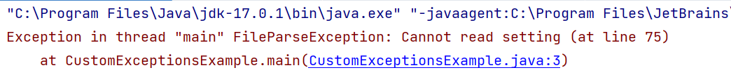
Using Custom Exceptions
Throw your exceptions like any other:
If your exception derives from Exception → handle it obligatory
If it derives from RuntimeException → handle it optionally
throw new FileParseException(
"Cannot read setting", 75);

Slide 38

Best Practices
Working with Exceptions the Right Way

Slide 39
Using The Catch Block
The catch blocks should:
Begin with the exceptions lowest in the hierarchy
Continue with the more general exceptions
Otherwise, a compilation error will occur
Each catch block should handle only these exceptions, which it expects
If a method is not competent to handle an exception, it should leave it unhandled
Handling all exceptions disregarding their type is a popular bad practice (anti-pattern)!

Slide 40
Common Exception Types in Java (1)
When an application attempts to use null in a case where an object is required: NullPointerException
A method has been passed an illegal or inappropriate argument: IllegalArgumentException
An array has been accessed with an illegal index: ArrayIndexOutOfBoundsException
An index is either negative or greater than the size of the string: StringIndexOutOfBoundsException

Slide 41
Common Exception Types in Java (2)
Attempt to convert an inappropriate string to a numeric type: NumberFormatException
When an exceptional arithmetic condition has occurred: ArithmeticException
Attempt to cast an object to a subclass of which it is not an instance: ClassCastException
When a file or network or other input / output operation has failed: IOException

Slide 42


Exceptions – Best Practices (1)
When throwing an exception, always pass to the constructor a good explanation message
The error message should make obvious what the problem is
The exception message should explain what causes the problem (and give directions how to solve it)
Good: "Size should be integer in range [1…15]"
Good: "Invalid state. First call Initialize()"
Bad: "Unexpected error"
Bad: "Invalid argument"

Slide 43
Exceptions – Best Practices (2)
Exceptions can decrease the application performance
Throw exceptions only in situations which are really exceptional and should be handled
Do not throw exceptions in the normal program control flow
The JVM could throw exceptions at any time with no way to predict them
E. g. StackOverflowError or OutOfMemoryError

Slide 44

Summary
…
…
…
Exceptions provide a flexible error handling mechanism
Try-catch allows exceptions to be handled
Unhandled exceptions crash with an error message
Try-finally ensures a given code block is always executed

Slide 45
Questions?
Notes:
45

Slide 46













SoftUni Diamond Partners

Slide 47


Educational Partners

Slide 48
Trainings @ Software University (SoftUni)
Software University – High-Quality Education, Profession and Job for Software Developers
softuni.bg
Software University Foundation
softuni.foundation
Software University @ Facebook
facebook.com/SoftwareUniversity
Software University Forums
forum.softuni.bg
48
Notes:
48

Slide 49

License
This course (slides, examples, demos, exercises, homework, documents, videos and other assets) is copyrighted content
Unauthorized copy, reproduction or use is illegal
© SoftUni – https://about.softuni.bg
© Software University – https://softuni.bg
Notes:
49

